Slide 1


UCF Rain Simulator
“ ” Project
R
Group 10:
Luke Falls
Adam Cutting
David Levy
Brenda Garcia

Slide 2

Introduction
Largest rain simulator of its kind in North America
Trouble with existing control system
Seeking Senior Design team to fix the problems

Slide 3
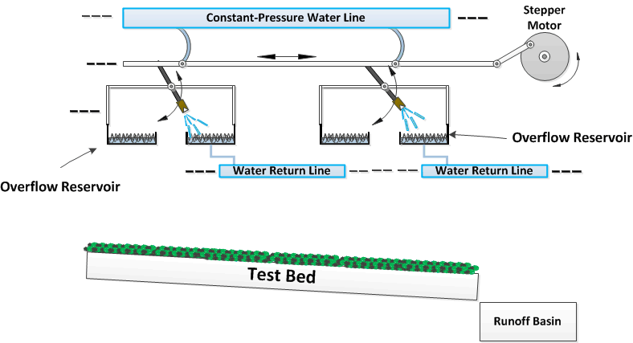
Introduction

Slide 4
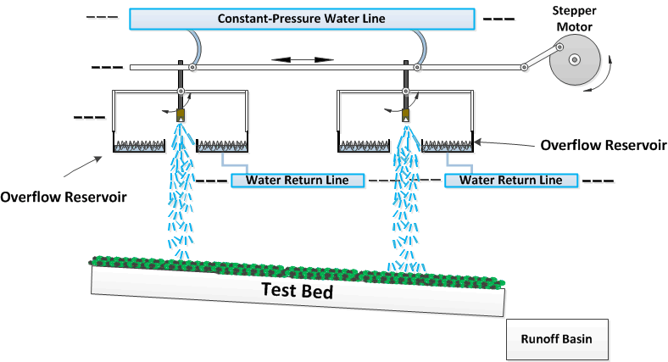
Introduction

Slide 5
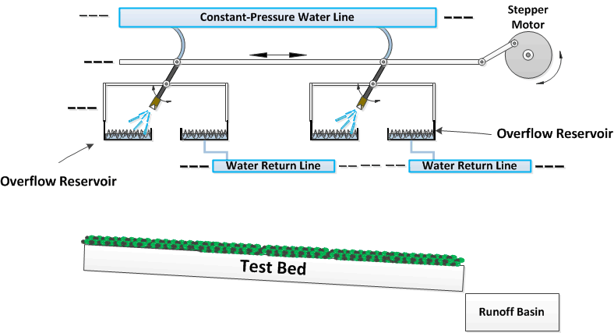
Introduction

Slide 6
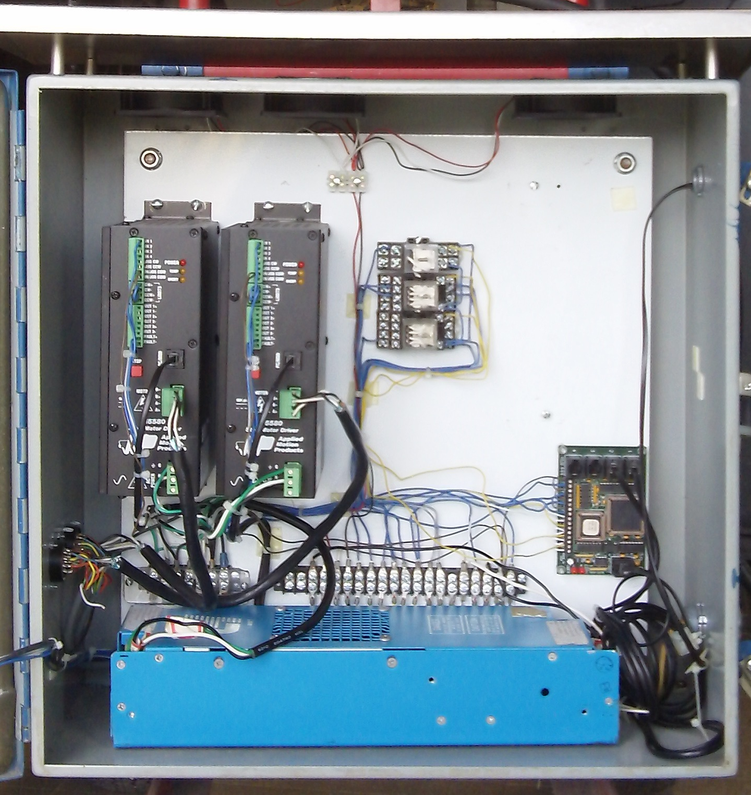
Existing Control System Overview
Communication to laptop is unreliable – HUB 444 Module
Power supply is intermittent
Does not deliver accurate rainfall intensities
Problems hinder their ability to meet simulation deadlines
Very Expensive: Approximately $ 5,000.00 for control system.
Far more capable than what is necessary for the application

Slide 7
Options
Try to fix existing system
- reprogram system
- repair wire connections
- risk destroying expensive components
2) Build a new system
- existing system could still be used
- more experience to be gained

Slide 8
Goals & Objectives
Reliable
Delivers accurate rainfall intensities
Rugged
Water resistant enclosure
Drop-in replacement for existing system
User friendly interface
Replace laptop with a single microcontroller
Integrate a wireless rain gauge

Slide 9
Specifications & Requirements
Two user inputs: Intensity and Duration
  0.5 -12 in/hr intensity input with 0.5 in/hr resolution
  1-120 minute duration input with 1 min resolution
Rain sensors need to be accurate within 0.25 inches
(2) motor drivers capable of sourcing at least 5.66 amps per phase to (2) bipolar stepper motors
Stepper motor power supply rating of 75 VA.

Slide 10
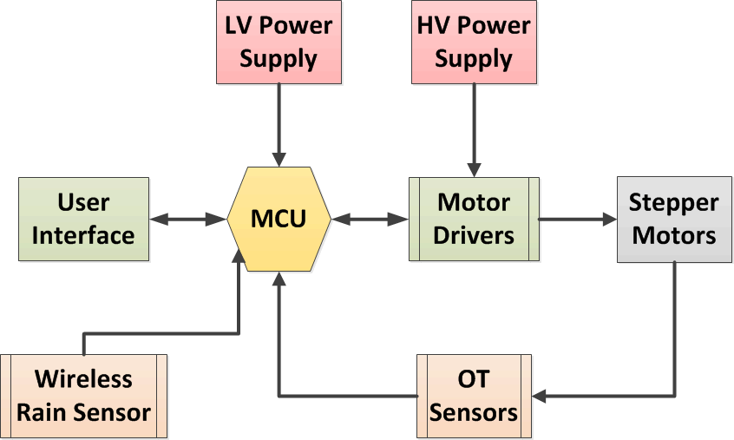
Control System Block Diagram

Slide 11
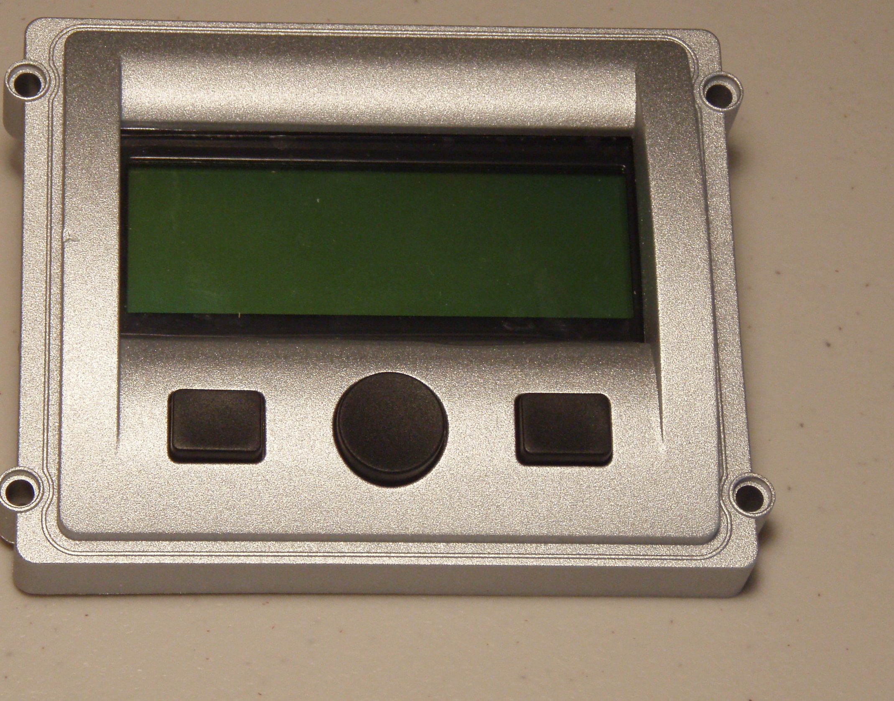
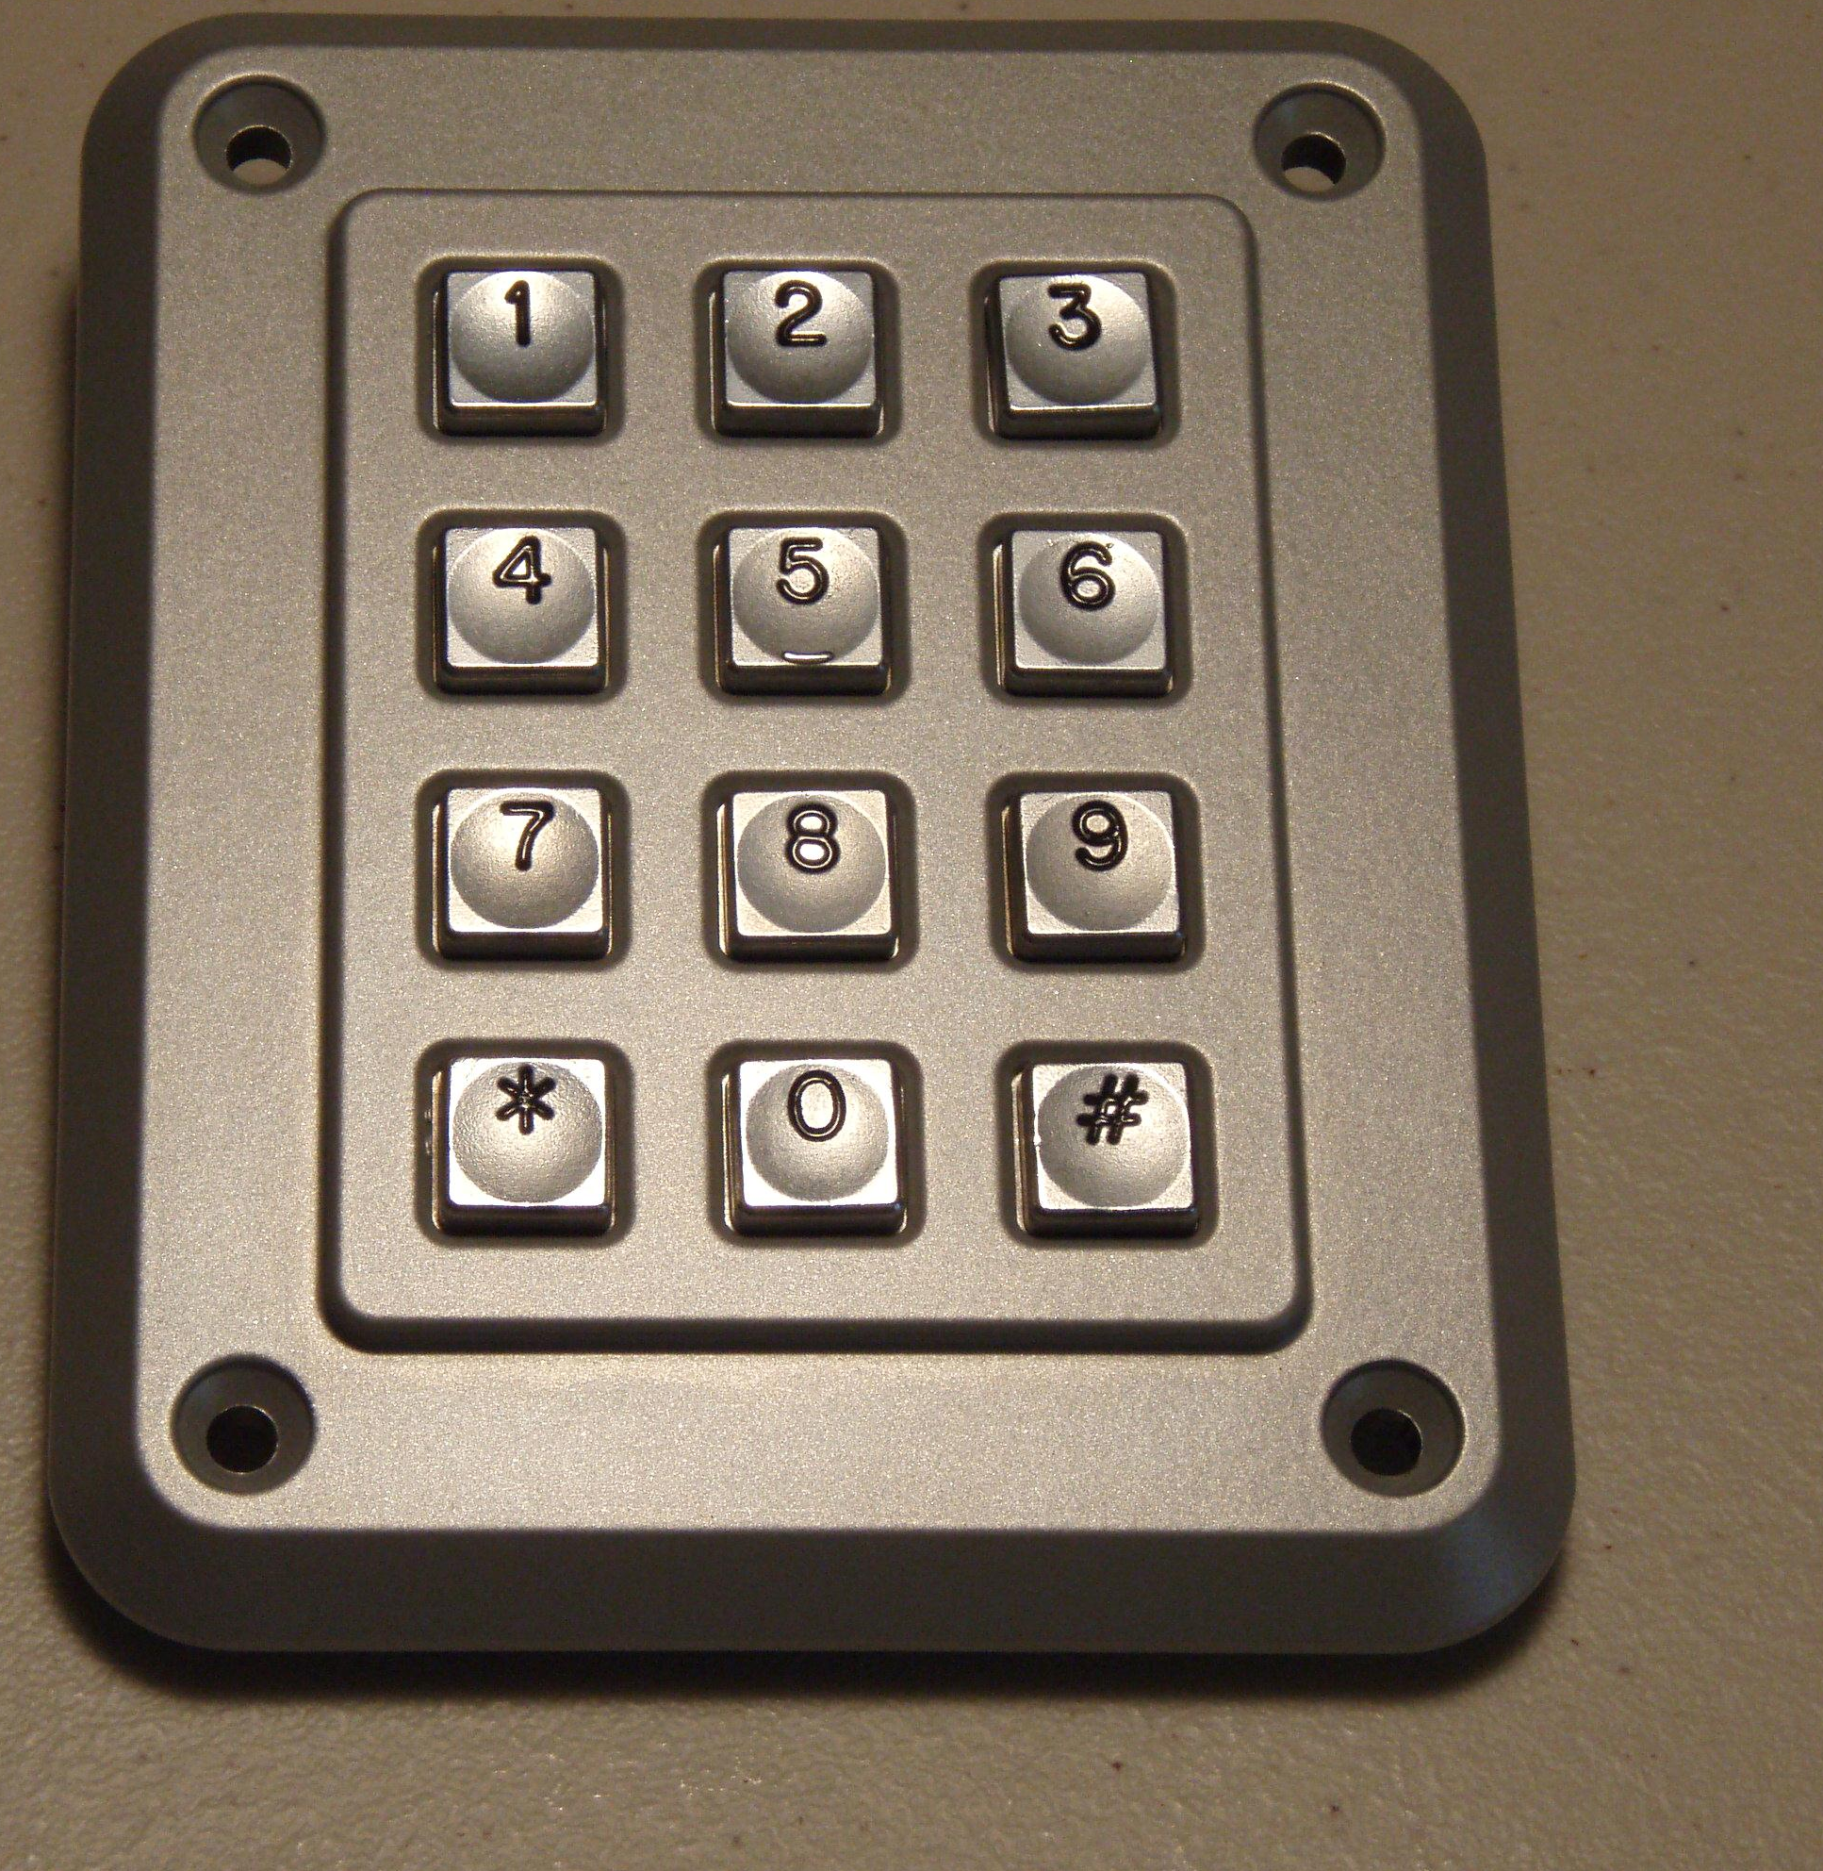
User Interface Components
Storm-Interface Display Bezel
  Impact Resistant
  4x20 Character LCD
  3 Navigation Buttons
  Weather Sealed for outdoor use
Storm-Interface Keypad
  Vandal and impact resistant
  Weather, water, and dust resistant (IP65)
  -40ºC to 100ºC Operating Temperature
  Operating Life of at least 4 million
  cycles per key
3.40”
4.20”
4.70”
3.90”

Slide 12
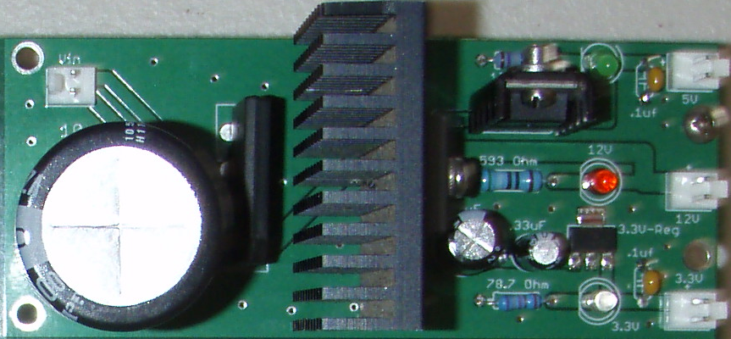
Low Voltage Power Supply Design

Slide 13














Low Voltage Thermal
12 Volt Regulator
$$V_{Drop}=6.4 Volts$$
$$T_{Ambient}=38\text{º}C$$
$$I_{Out}=2.7 Amps$$
$θ_{Total}=θ_{Junc−Case}+θ_{Case−HS}+θ_{HS−Amb}$ = 5.8$\text{º}$C/W
$$P_{Reg}=17.3 Watts$$
$T_{Junc}=T_{Amb}+ θ_{Total}×P_{Reg}$= 138.3$\text{º}$C < 150$\text{º}\text{C}$
5 Volt Regulator
$$V_{Drop}=7 Volts$$
$$T_{Ambient}=38\text{º}C$$
$$I_{Out}=0.5 Amps$$
$θ_{Total}=θ_{Junc−Amb}$ = 53$\text{º}$C/W
$$P_{Reg}=3.5 Watts$$
$T_{Junc}=T_{Amb}+ θ_{Total}×P_{Reg}$= 126.2$\text{º}$C < 150$\text{º}\text{C}$
3.3 Volt Regulator
$$V_{Drop}=8.7 Volts$$
$$T_{Ambient}=38\text{º}C$$
$$I_{Out}=0.1 Amps$$
$θ_{Total}$ = 5.8$\text{º}$C/W
$$P_{Reg}=0.87 Watts$$
$T_{Junc}=T_{Amb}+ θ_{Total}×P_{Reg}$= 84.1$\text{º}$C < 150$\text{º}\text{C}$

Slide 14
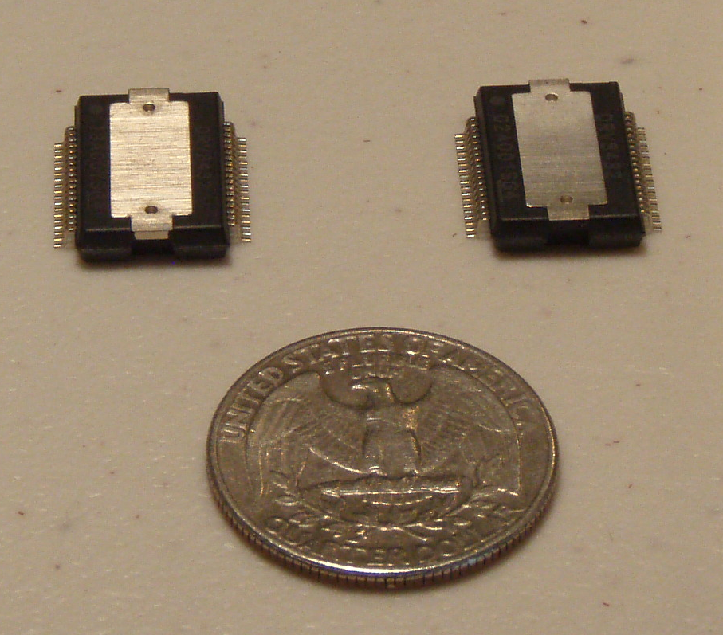
TI DRV8432 Motor Driver
Operating Supply Voltage – up to 52VDC
Continuous Output Current – 2 @ 7A
Integrated self protection from undervoltage, overtemperature, overcurrent, and short circuit
Up to 97% efficient
Each IC contains two full H-Bridges
Does not require external flyback diodes

Slide 15
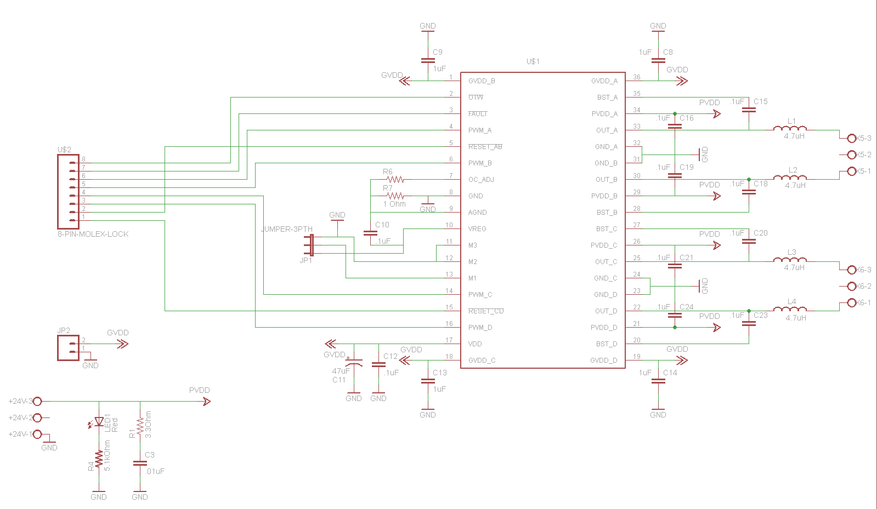
TI DRV8432 PWM Motor Driver

Slide 16
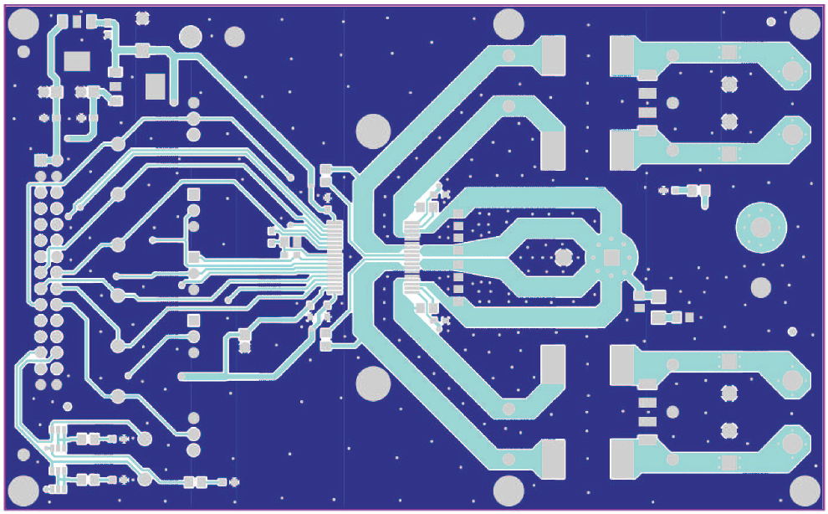
Motor Driver PCB Considerations
2 oz copper on both top and bottom layers for improved thermal performance and lower noise is recommended
Short and wide ground traces with multiple vias to ground plane to reduce noise
Clear space around IC to improve heat sinking

Slide 17
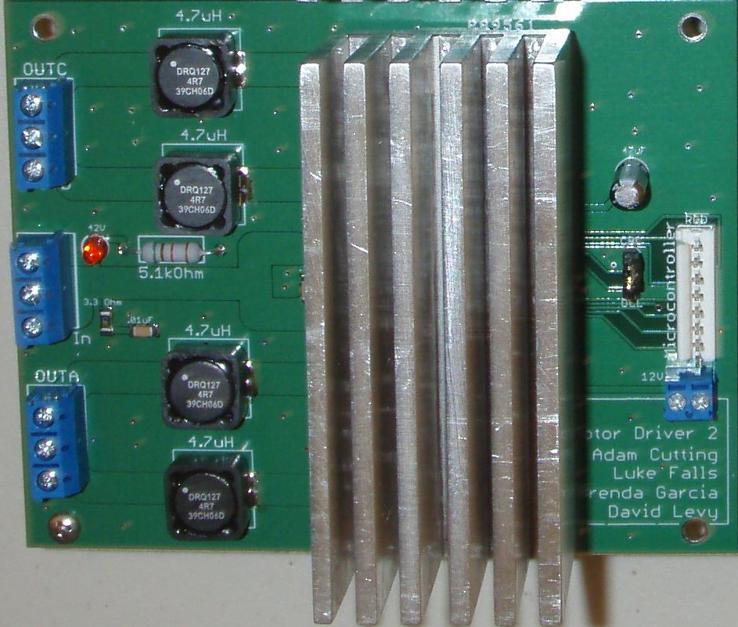
Motor Driver PCB

Slide 18
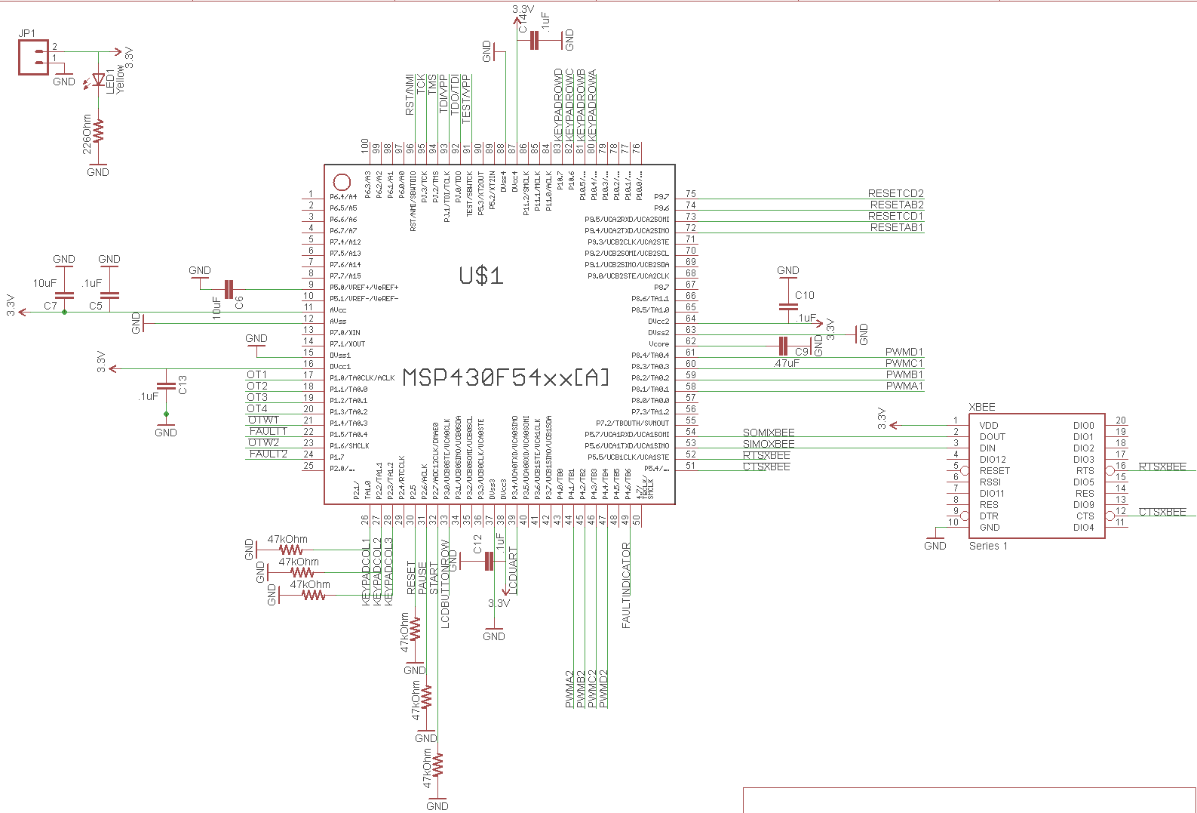
Microcontroller Sheet 1

Slide 19
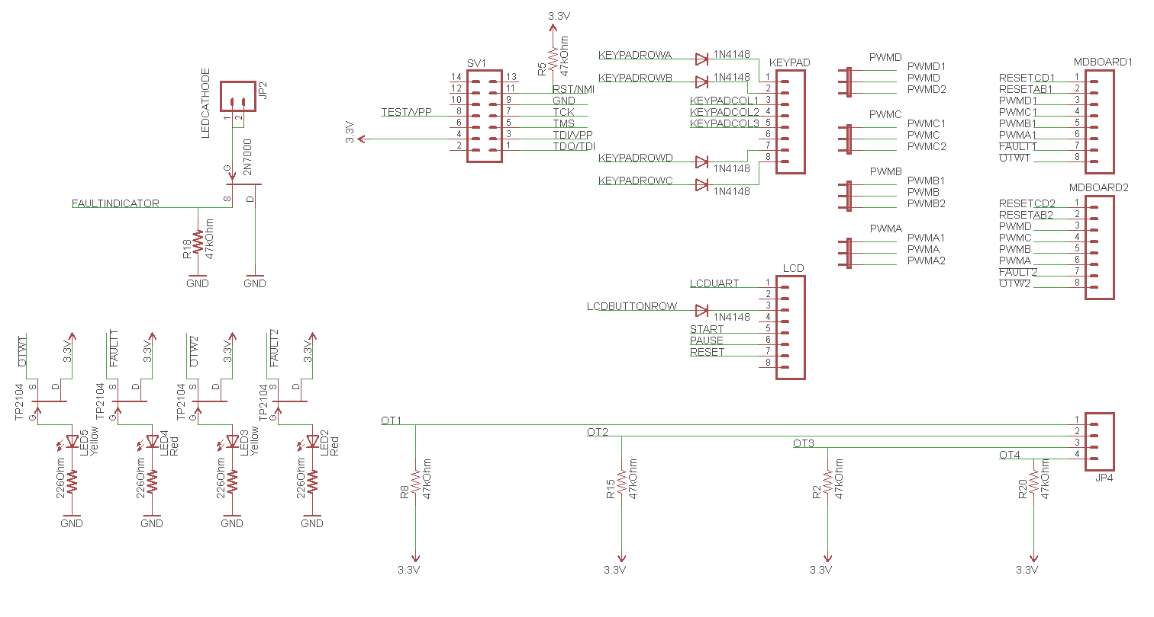
Microcontroller Sheet 2

Slide 20
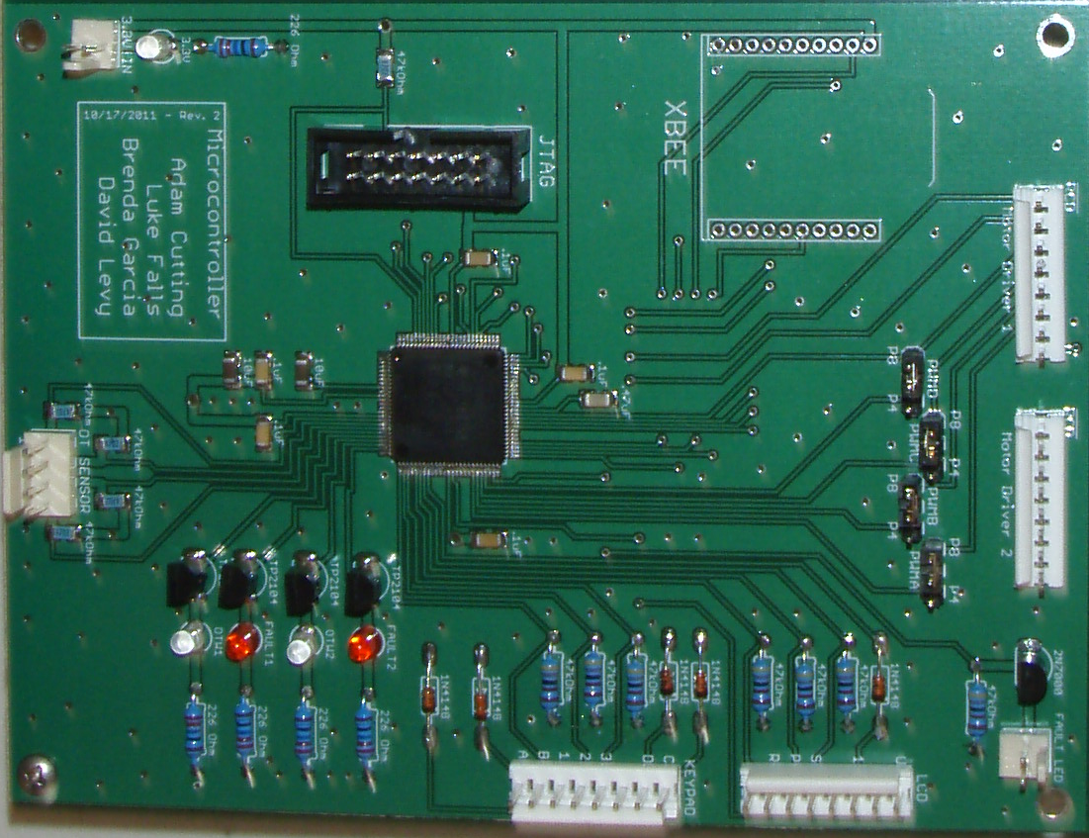
Microcontroller PCB

Slide 21
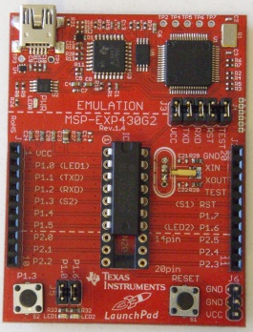
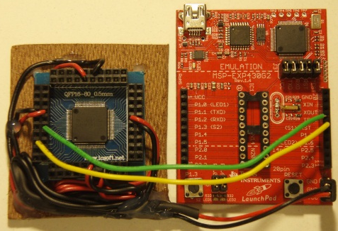
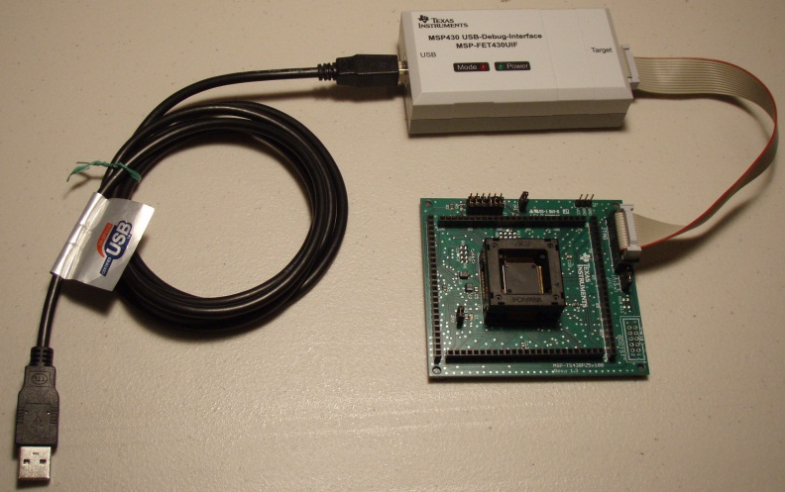
Microcontroller Selection
Launchpad
MSP430F5435
MSP430F5438a
 | GPIO | Communication Modules | RTC | External Interrupts | PWM Outputs | Free Target Board
G2452 | 14 | SPI, I2C | No | 16 | 3 | No
F5435 | 67 | SPI, I2C, UART | Yes | 16 | 15 | No
F5438a | 87 | SPI, I2C, UART | Yes | 16 | 15 | Yes

Slide 22
Software Design Approach
Make the system interrupt driven
Simplify code using interrupt vectors
Utilize the MCU’s built-in peripheral modules
Modularize the software
Verify desired functionality of all software on the target board
Write all code in C using TI’s Code Composer Studio IDE
Implement a software state machine

Slide 23
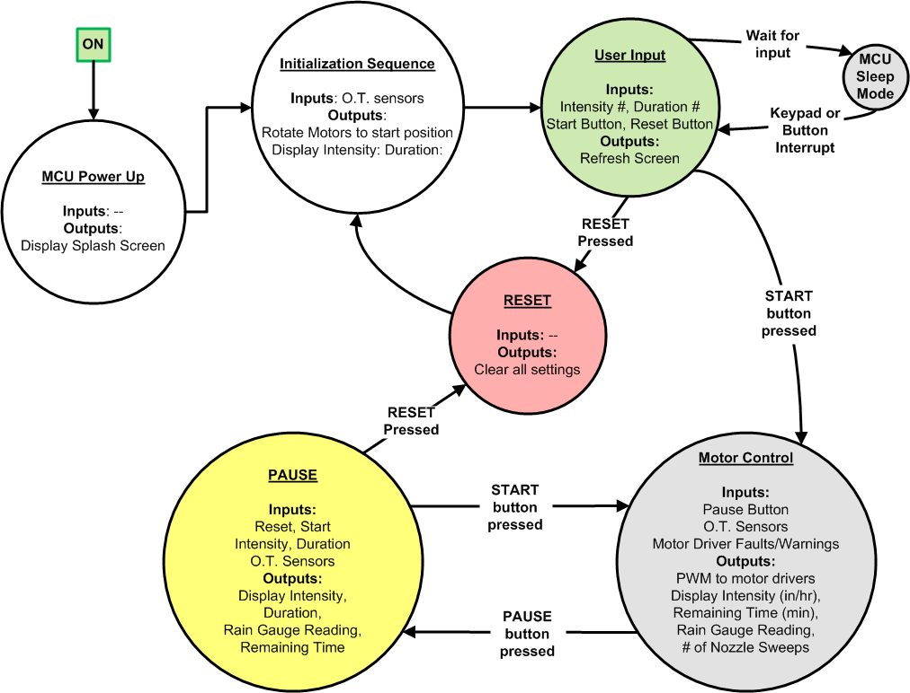
Software Design

Slide 24
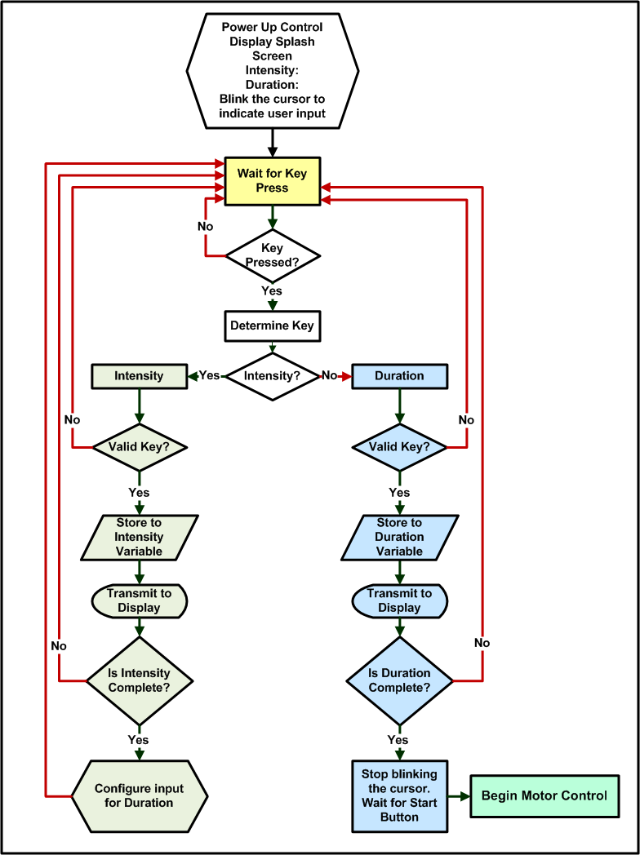
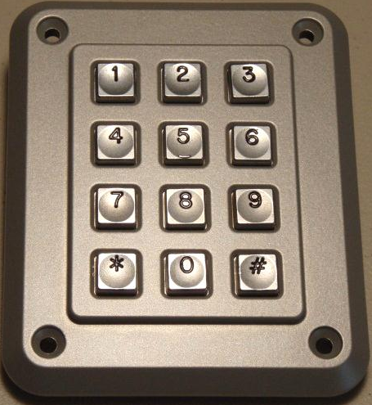
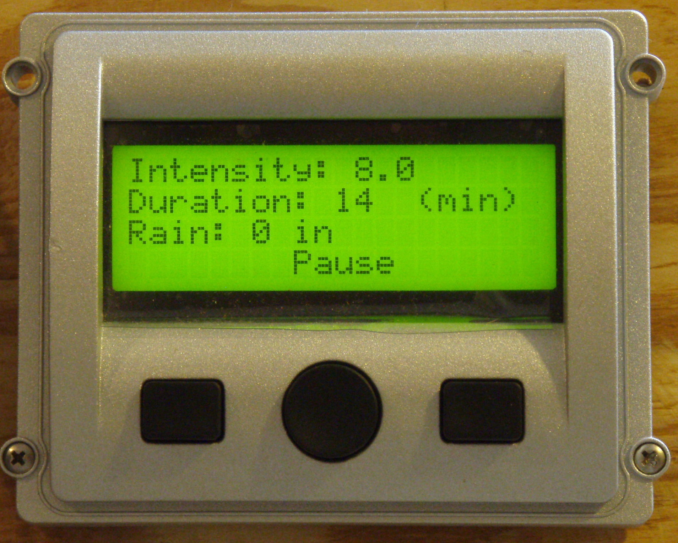
User Input
Software Routine

Slide 25
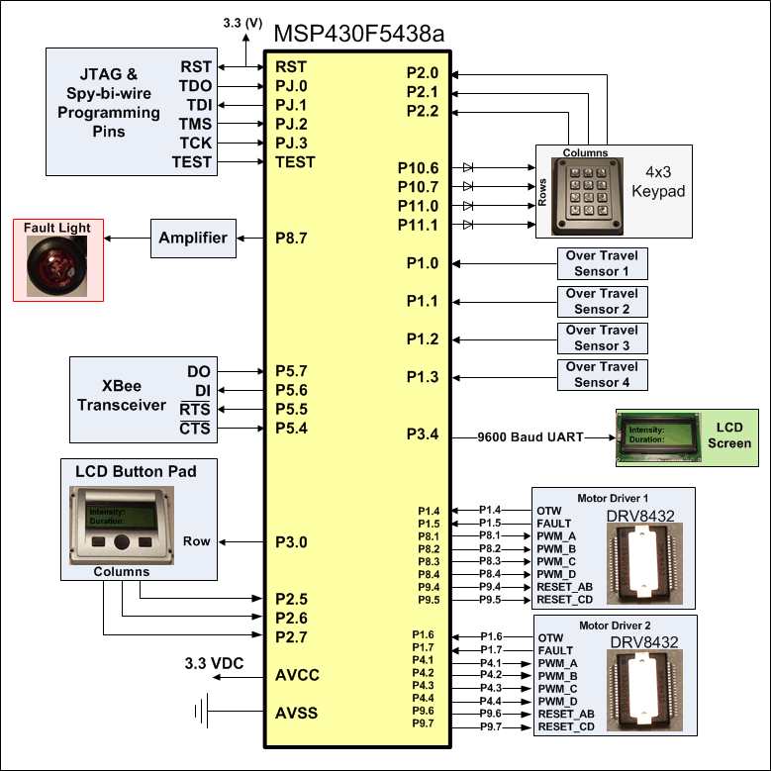
Microcontroller I/O

Slide 26
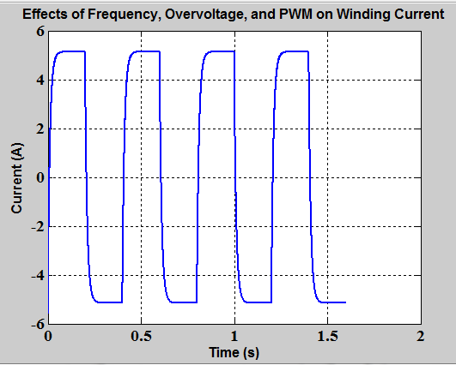
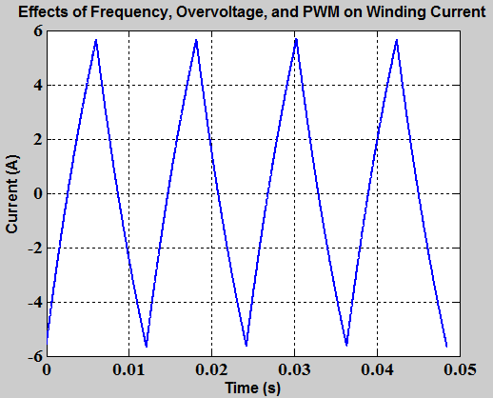
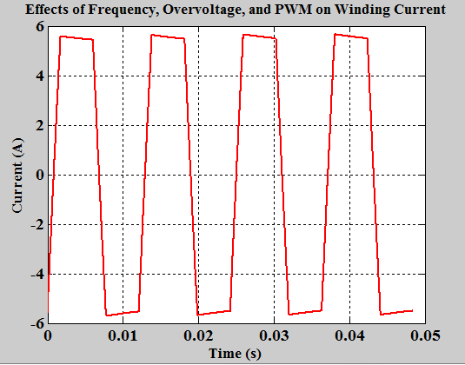
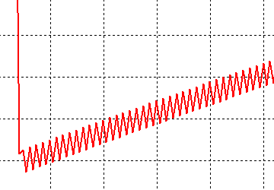
PWM Motor Control Problems
PWM Frequency = 40 kHz
PWM Duty Cycle = 7%
16 Full Steps
Motor Speed = 50 steps/sec
PWM Frequency = 40 kHz
PWM Duty Cycle = 25%
Motor Speed = 330 steps/sec
PWM Frequency = 40 kHz
PWM Duty Cycle =
100%, then 7%
Motor Speed = 330 steps/sec

Slide 27
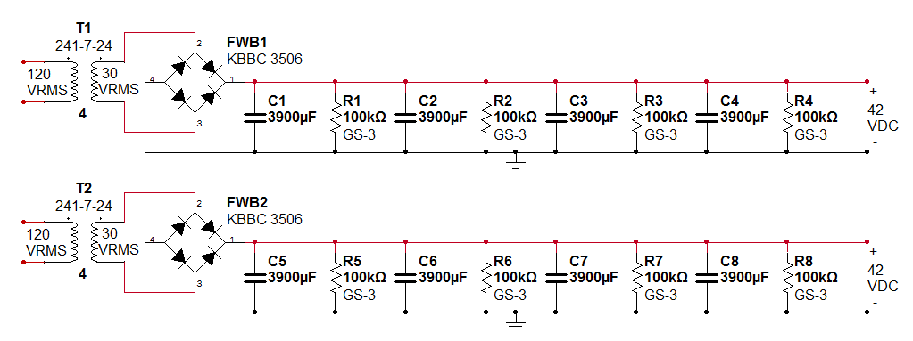
42 VDC Power Supply
Provides power to the stepper motors via the drivers
Simple unregulated power supply
  Handles back EMF better than a SMPS

Slide 28
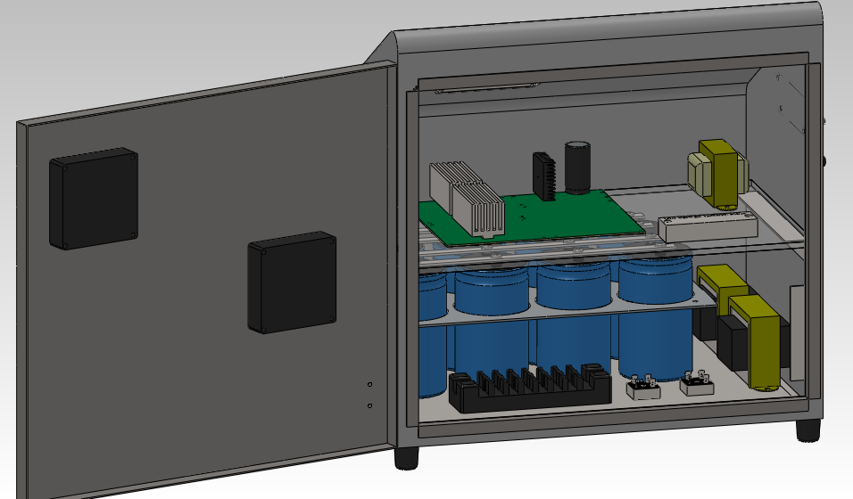
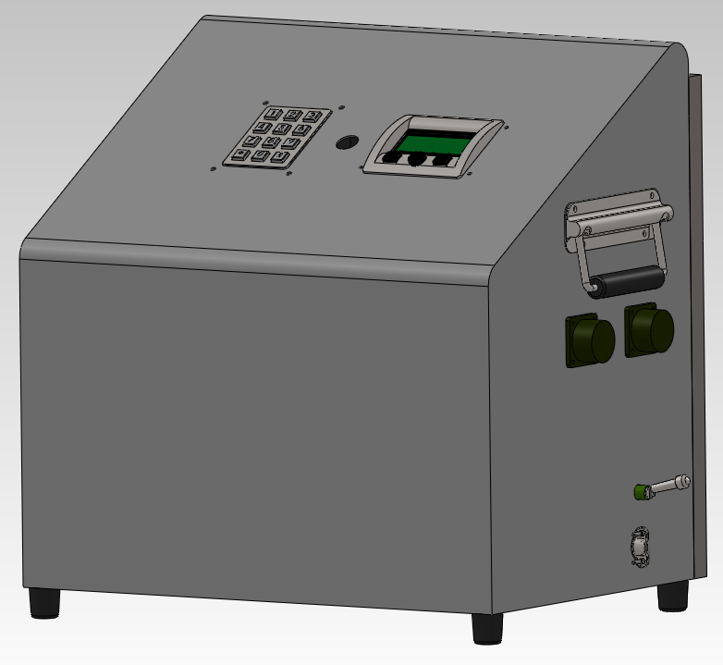
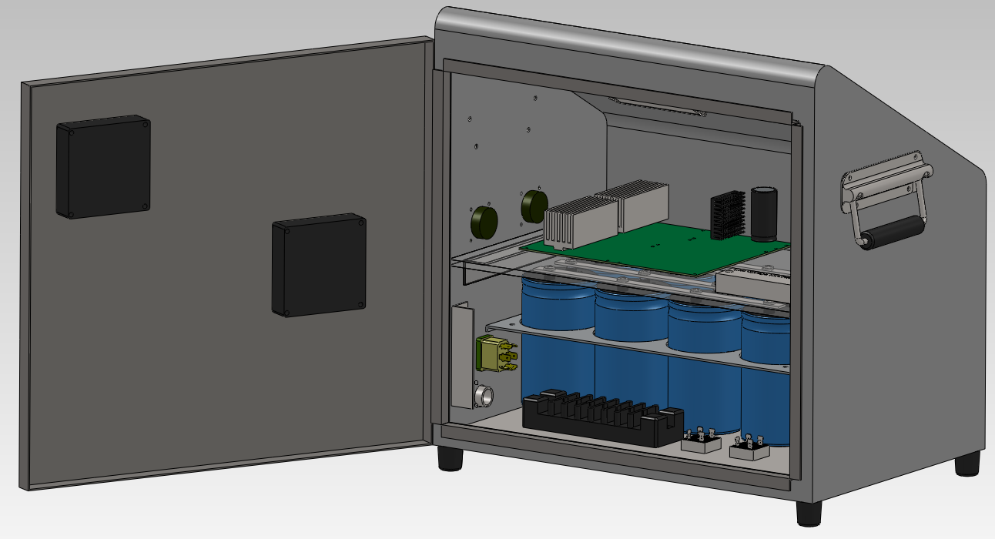
Enclosure

Slide 29
Wireless Rain Sensor Uses
  Measure amount of rainfall at specific moments during simulation
  Measure rainfall rate over the duration of the simulation
  Check calibration of nozzle sweep-stop frequency
  To indirectly check the water pressure of the rain nozzles

Slide 30
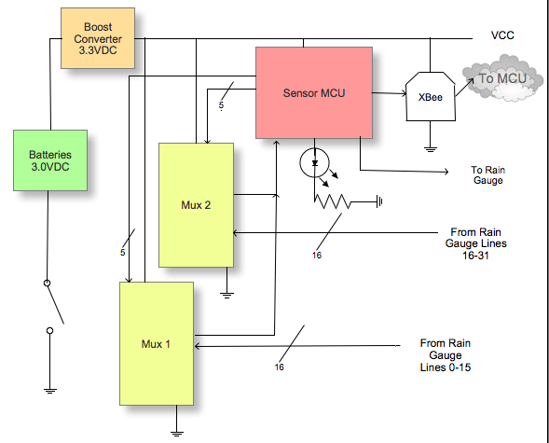
Wireless Rain Sensor- Block Diagram

Slide 31
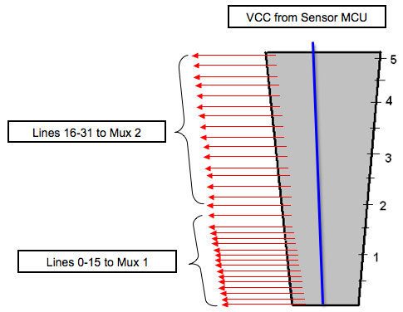
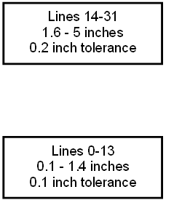
Wireless Rain Gauge - Design
Open Circuit without any water in the gauge

Slide 32
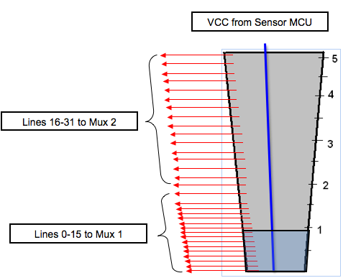
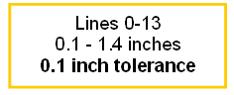
Wireless Rain Gauge - Design
First 9 levels submerged under water

Slide 33
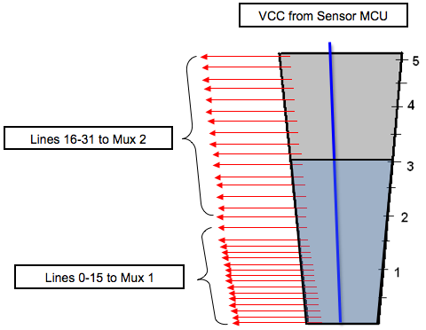
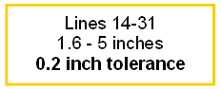
Wireless Rain Gauge - Design
First 20 levels submerged under water

Slide 34
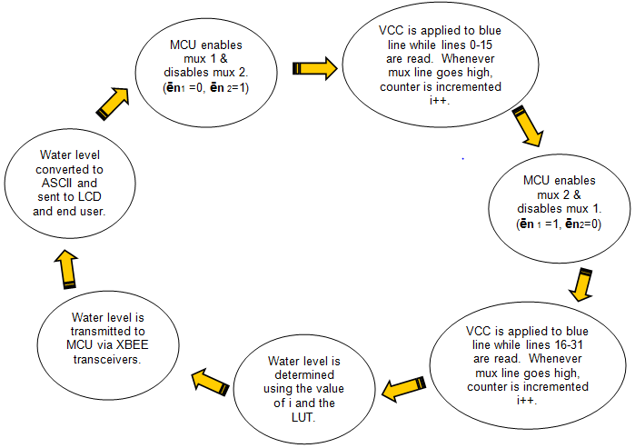
Wireless Rain Sensor - Software
Start

Slide 35
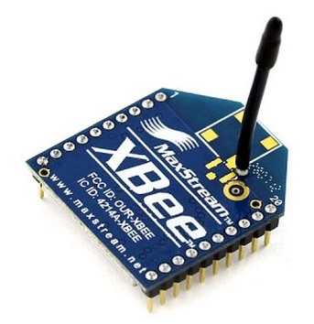
Wireless Rain Sensor - XBee 2.4GHz
Requires 3.3v Input
Integrated whip antenna
Easy to Integrate to PCB
UART Serial Communication to MCU

Slide 36
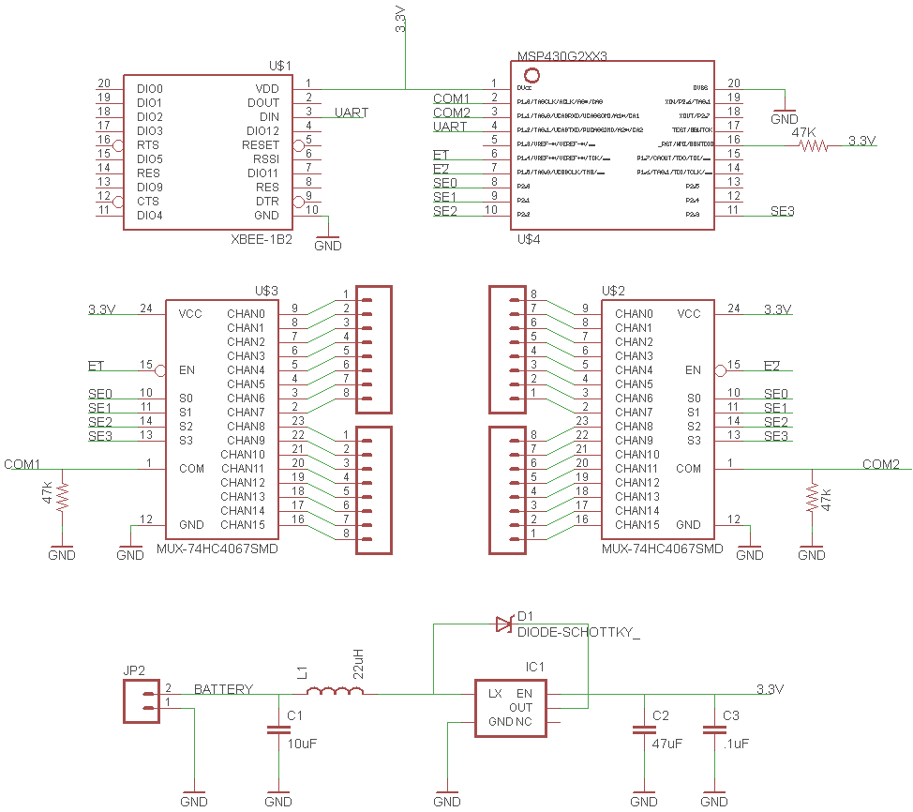
Wireless Rain Sensor Schematic

Slide 37
Functional Acceptance Testing
User input varied from 0.1 to 12.0 inches per hour
Duration input varied from 1 to 999 minutes
All invalid entries are ignored
Simulation count down timer verified
Over-travel sensor interrupt trigger
Motor initialization sequence verified
Software algorithms correctly modify motor speed and pause times
Motor driver fault indication verified
Wireless rain sensor transmits correct data within tolerance
Power supplies meet specs

Slide 38
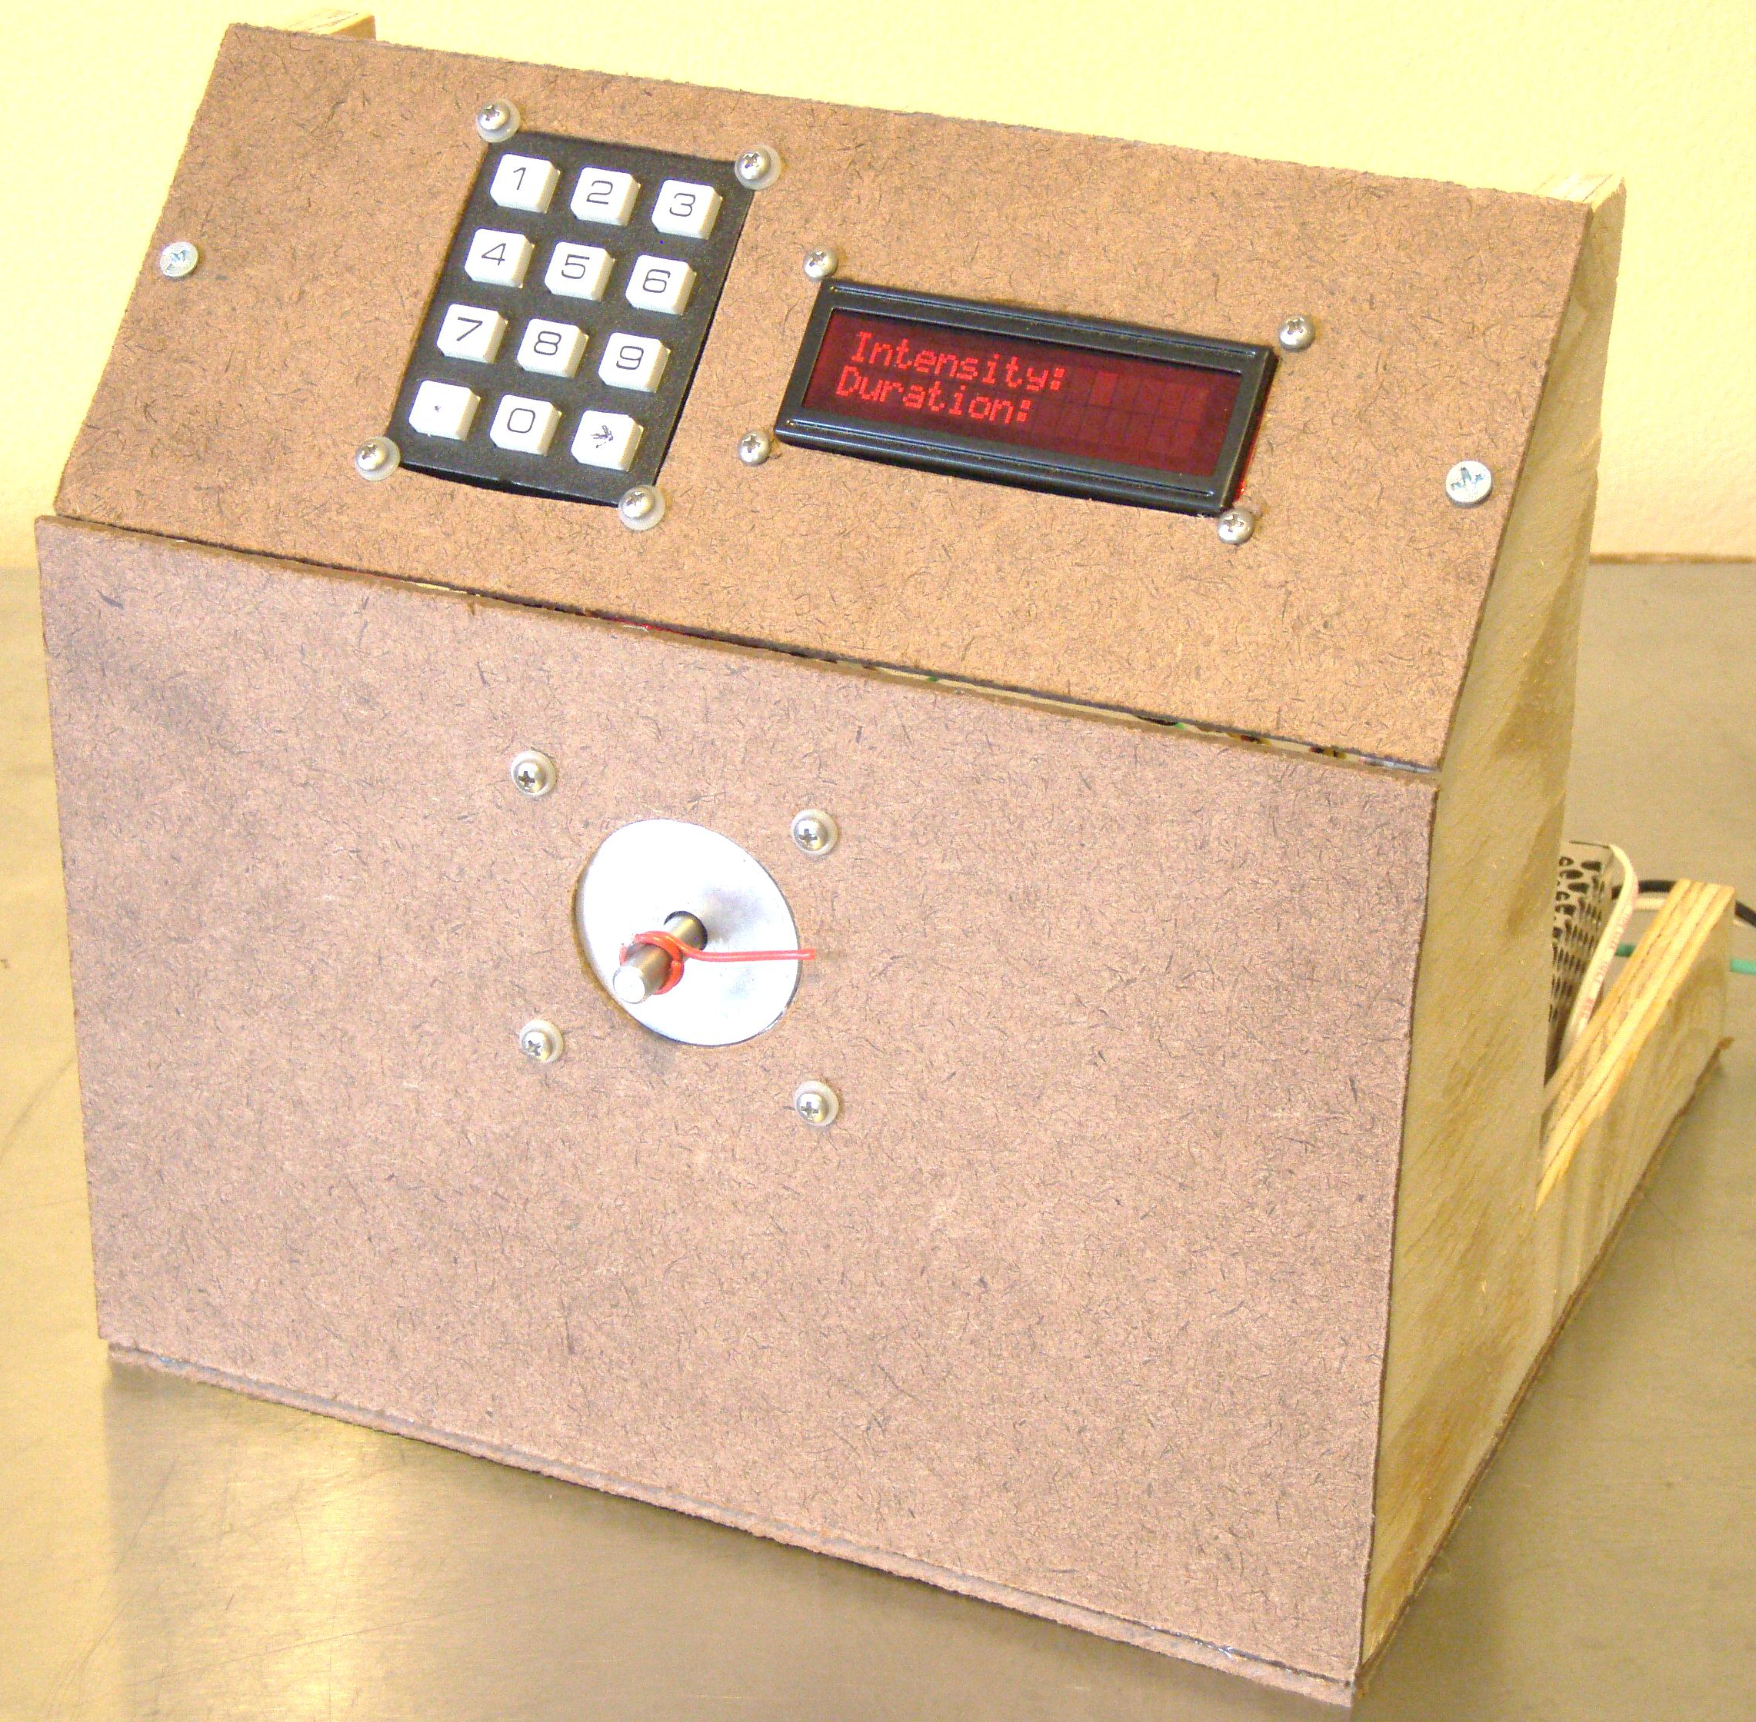
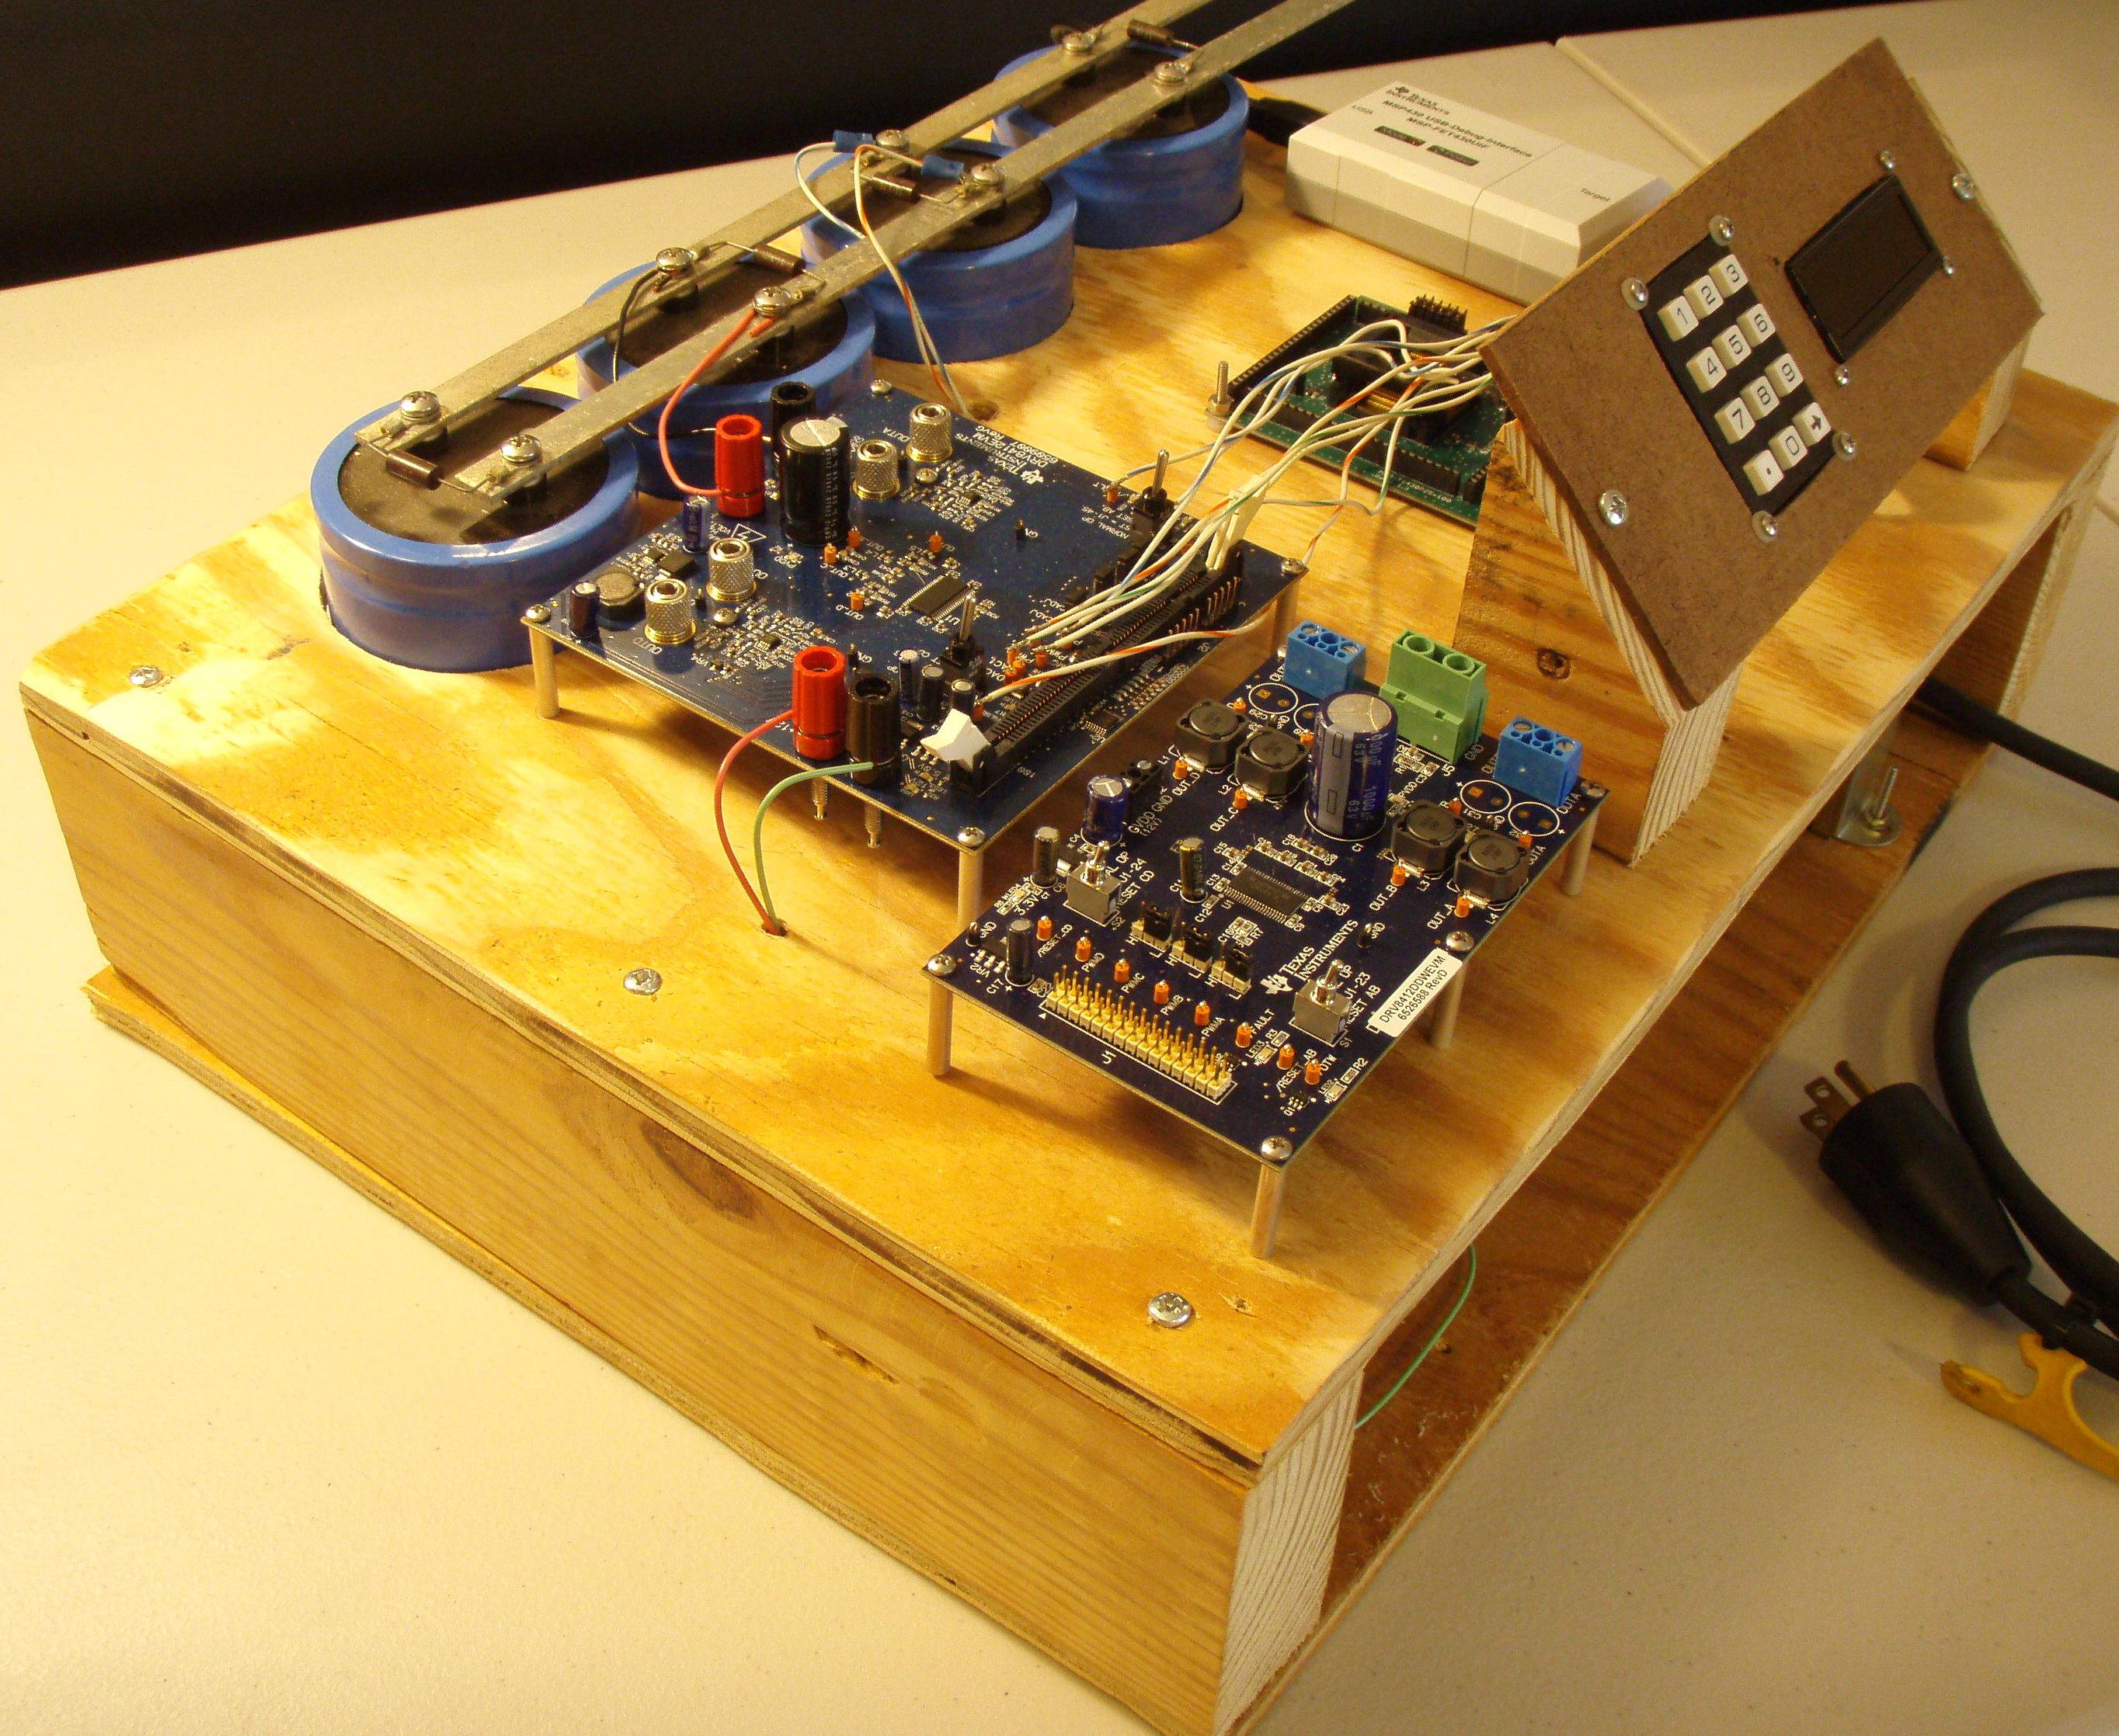
Budget & Financing - Development
Development Costs
 | Item | Quantity | Projected Cost | Actual Cost
1 | Small Scale Model | 1 | $150.00 | $90.34
2 | MSP430 Development Board | 4 | $17.20 | $17.20
3 | Motor Driver Dev Kit | 2 | $449.00 | FREE
4 | MSP430F5438A Target Board | 1 | $149.00 | FREE
5 | JTAG Programmer | 1 | $99.00 | FREE
6 | Low Voltage Power Supply | 1 | $0.00 | $63.97
7 | Misc. Wire and Hardware | 1 | $15.00 | $20.00
 |  | Total: | $879.20 | $191.51
Rev1
Rev2

Slide 39
Budget & Financing
Costs for Rain Simulator
 | Item | Quantity | Projected Cost | Actual Cost
1 | Main Board – Including Components | 1 | $200.00 | $177.82
2 | Custom Stainless Steel Enclosure | 1 | $900.00 | FREE
3 | High Voltage Power Supply | 1 | $200.00 | $37.56
4 | Wireless Rain Sensor | 1 | $65.00 | $60.73
5 | Hardware and Enclosure | 1 | $100.00 | $136.28
6 | Misc. Components | 1 | $100.00 | $75.50
7 | Storm-Interface LCD | 1 | $92.53 | FREE
8 | Storm-Interface Keypad | 1 | $64.72 | FREE
9 | Eagle Professional License | 1 | $1494.00 | FREE
10 | Sampled Components | 1 | $80.18 | FREE
11 | Development Costs | 1 | $200.00 | $191.51
 |  | Total: | $3,296.43 | $679.40

Slide 40
Questions?

Slide 41
Wireless Rain Sensor - Demo
Rain Sensor LUT
Number of Lines Submerged | Water Level Reading (inches)
1 | 0.1
2 | 0.2
3 | 0.3
4 | 0.4
5 | 0.5
6 | 0.6
7 | 0.7
8 | 0.8
9 | 0.9
10 | 1
11 | 1.1
Rain Sensor LUT
Number of Lines Submerged | Water Level Reading (inches)
12 | 1.2
13 | 1.3
14 | 1.4
15 | 1.6
16 | 1.8
17 | 2
18 | 2.2
19 | 2.4
20 | 2.6
21 | 2.8
22 | 3
Rain Sensor LUT
Number of Lines Submerged | Water Level Reading (inches)
23 | 3.2
24 | 3.4
25 | 3.6
26 | 3.8
27 | 4
28 | 4.2
29 | 4.4
30 | 4.6
31 | 4.8
32 | 5

